Slide 1
How it works
Put simply: Random forest builds multiple decision trees and merges them together to get a more accurate and stable prediction.
One big advantage of random forest is that it can be used for both classification and regression problems, which form the majority of current machine learning systems.

Slide 2
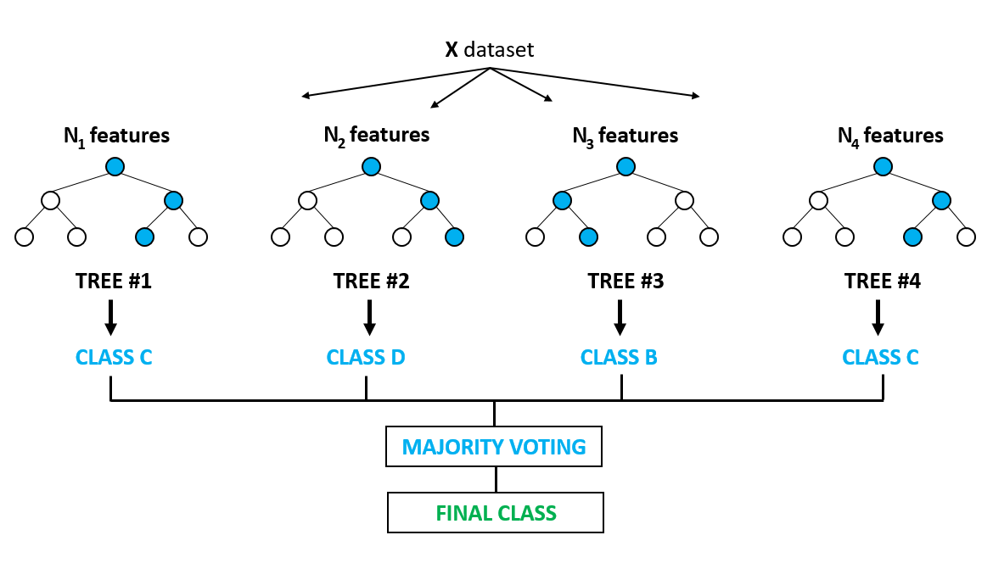
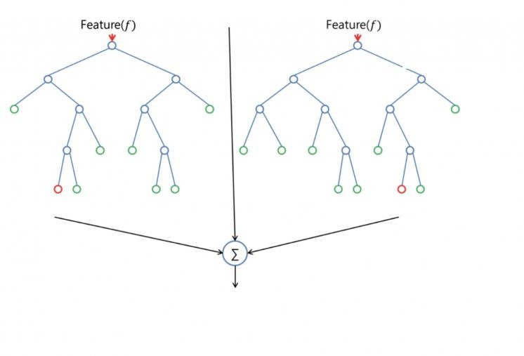
Example of two Decision tress

Slide 3
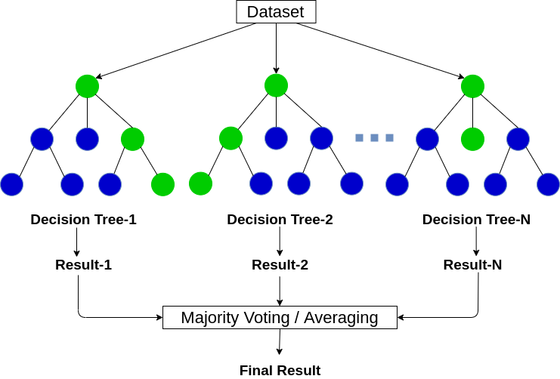

Slide 4
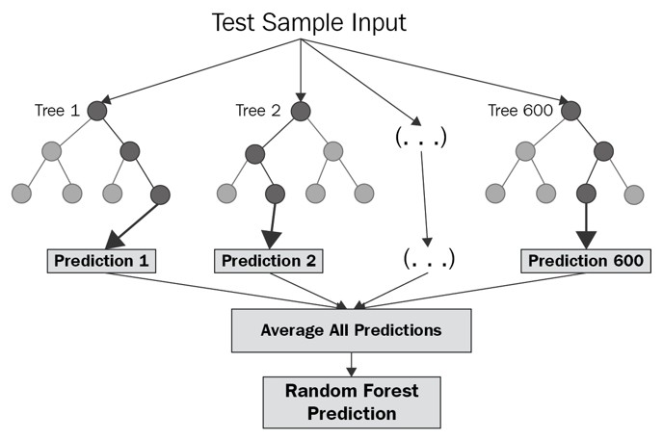

Slide 5
Difference between DT and RF
The random forest algorithm randomly selects observations and features to build several decision trees and then averages the results.
Another difference is "deep" decision trees might suffer from overfitting.
Most of the time, random forest prevents this by creating random subsets of the features and building smaller trees using those subsets.

Slide 6
Thanks

